Slide 1

Sprint Review 4
Thursday, 29th October

Slide 2







Hello Again 👋

Slide 3
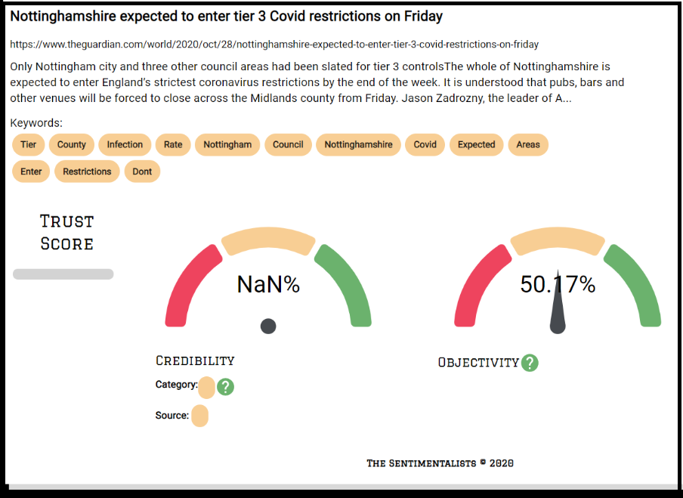

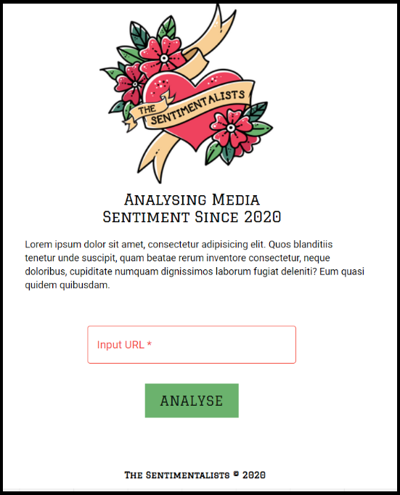


...and our first MVP was born! 👷‍♀️
Creation of the App TheSentimentalists.github.io
Scans the content of a News Article and provide insights of sentiment / intent behind them
Main Features:
URL input by the user
Article Details (Title, Summary, Keywords / Tags)
Sentiment Analysis (Polarity, Subjectivity)
Website Credibility (Score, Category, Source) via API call
Main technology used:
React / JS ; AWS (lambda); Python & Rule based NLP methods
Jyo

Slide 4
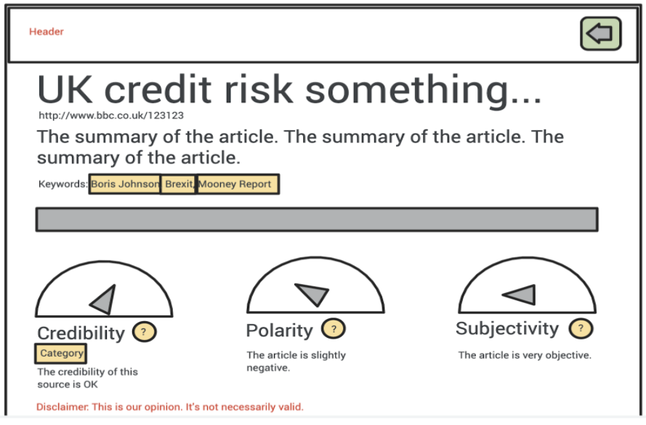
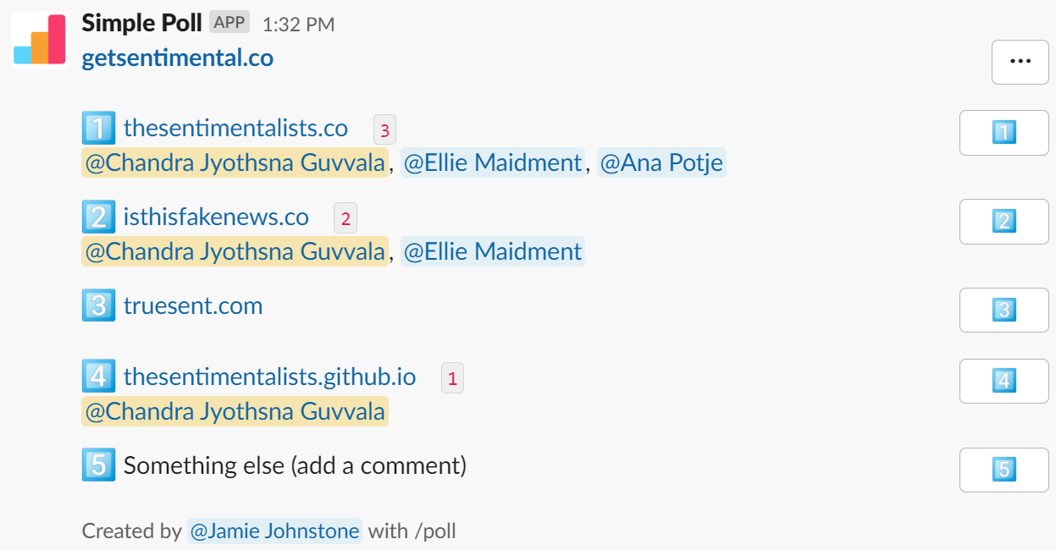
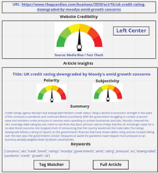
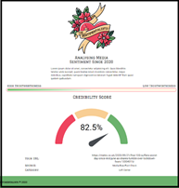
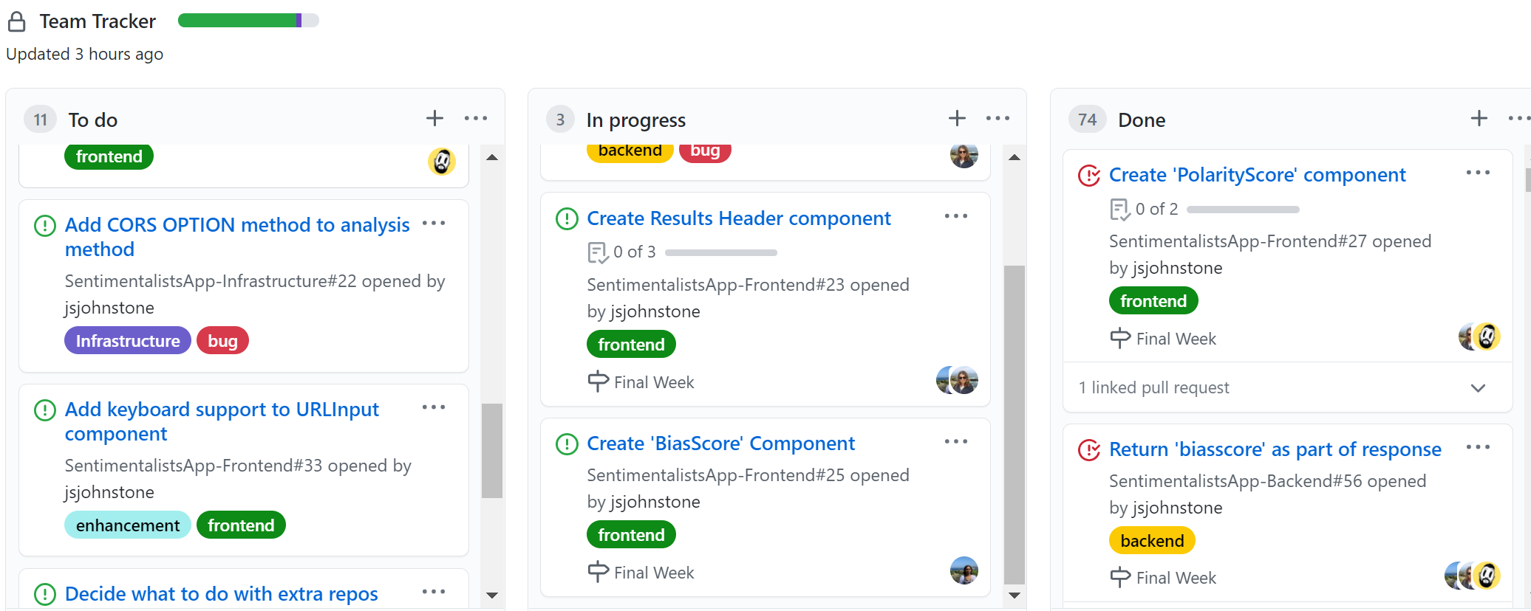
What we did ✅
Reviewed priorities and defined the ‘final features’ for our MVP

Slide 5
What we did ✅
...and implemented those features!
✅ ‘Subjectivity Score’ component
✅ split ‘Credibility Score’ from ‘Display Result’
✅ ‘Polarity Score’ component
✅ article ‘Summary’ component
✅ return article header/summary from API
✅ refactor ‘Display Results’
✅ return article keywords
✅ loading/processing function
✅ frontend error handling
✅ New production URL API (earlier test)
✅ ‘Trust Score’ component
✅ return ‘Trust Score’ from API
✅ ‘Results Header’ component
✅ frontend pipeline automation
Ellie

Slide 6
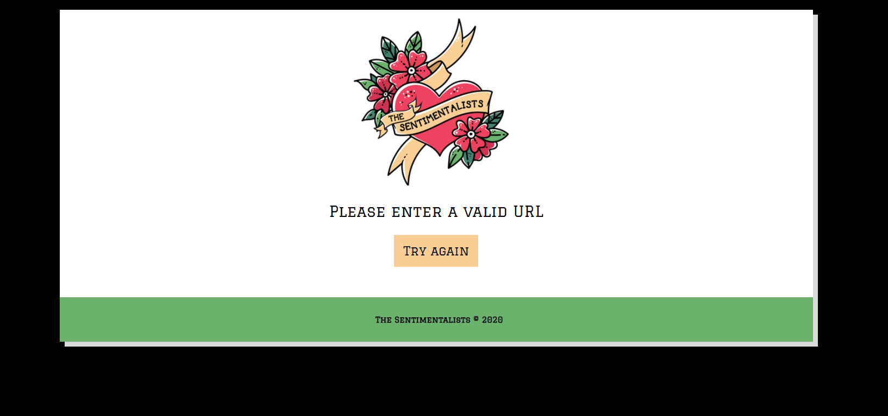


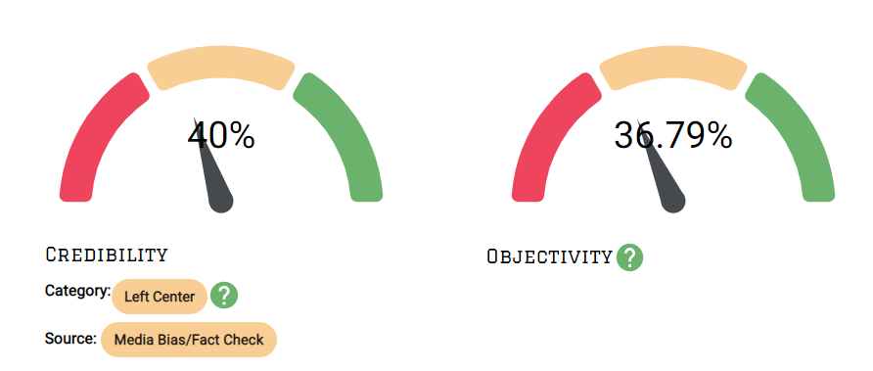

Front End
<ErrorBoundary/>
Components we’ve built (tooltips, chips, etc)
Frontend Pipe line built with Node.js on Github
<Chip/>
<GaugeChart/>

Slide 7
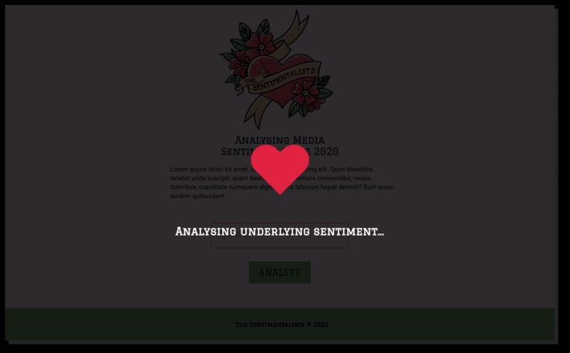
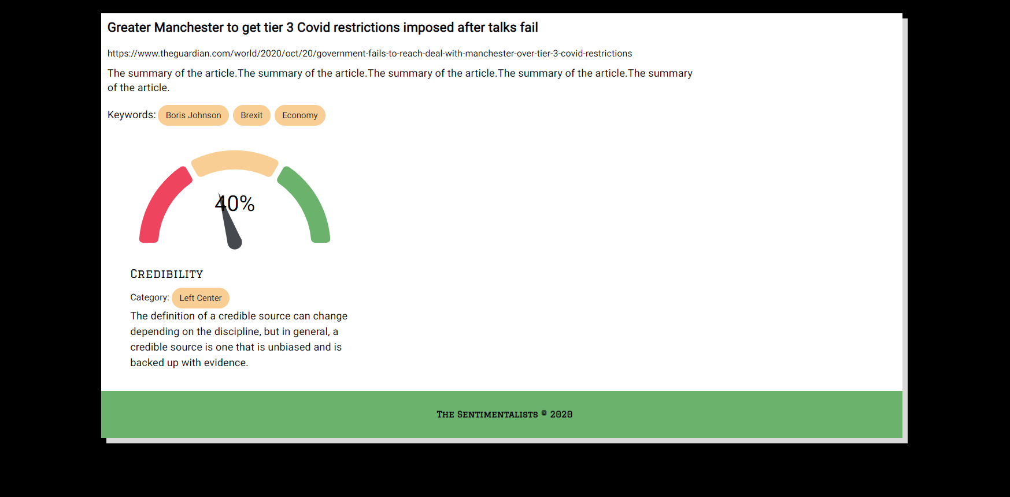
UX/UI
Presenting each set of data in the most user-friendly format
Creating meaningful visualisations
Considerations about what will render in the event of an error
Visual signifiers - what can users see while the backend is performing the analysis
Jyo

Slide 8






Trust Analysis
green > 70%
yellow < 70% >
red < 70%
Progress bar to indicate Trustworthiness of an article
Trust Score :
calculated considering credibility, objectivity and polarity score
Error message in a scenario where value/s are unavailable
Python , Pytested code with Material-ui , React at the front end
Ana

Slide 9
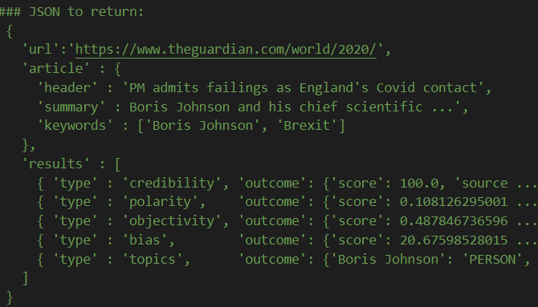
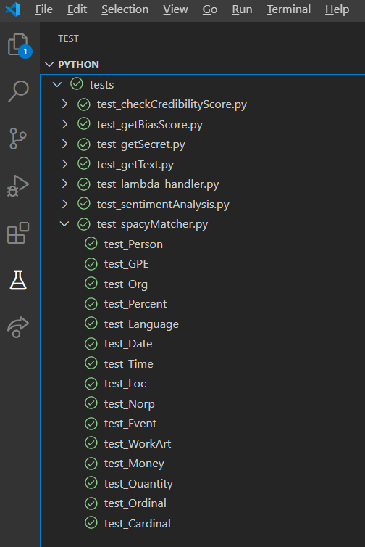
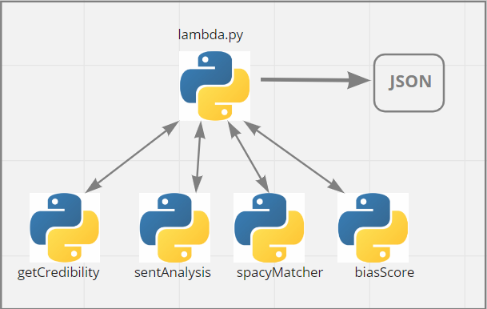
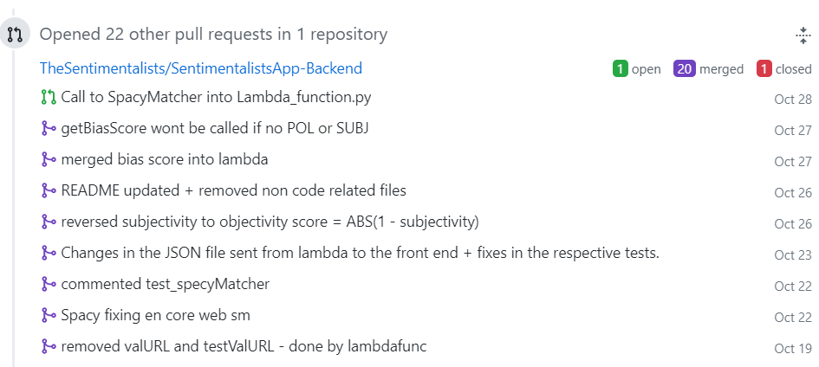
Back End⚙️
Finalized Lambda_Function.py
JSON returned to frontend
Pytests validated
Backend README updated
Jam

Slide 10
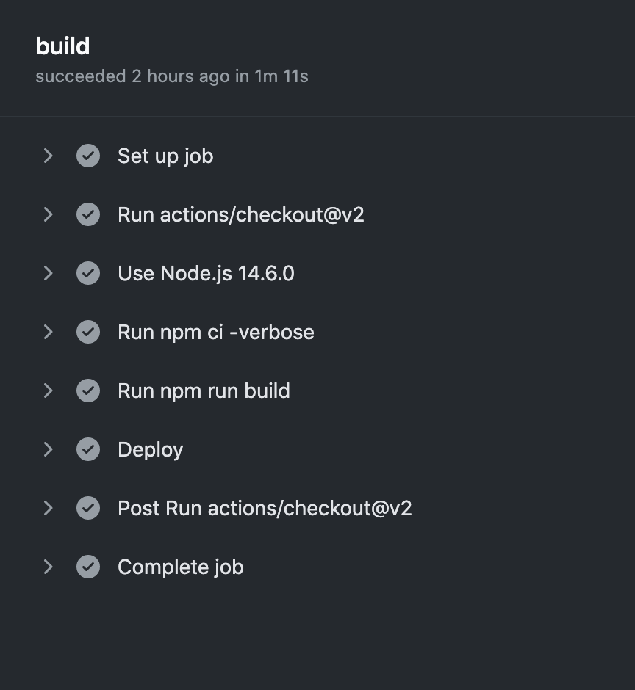
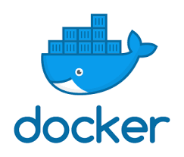
Pipeline Fun and Games
Built the frontend pipeline!
Regex Module and Docker Containers!
NLTK Assets, and Lambda upload limits!
...and X-Ray Profiling!
Notes:
Pipeline:
Completed the frontend pipeline to get builds continuously deployed to github io hosting environment
Regex Module:
‘Regex’ python module had to be compiled in an AWS Lambda-like environment, as certain environment variables were being hard-coded at installation.
Solved by using docker containers to build our deployment package
NLTK Assets:
NLTK library requires a 13.7MB resource pack that was being downloaded with every invocation, causing cold starts to take 25+ seconds.
Bundling this in deployment package took us over max file limit for API uploads.
Re-architected to download resource pack during build pipeline, and then upload deployment package to S3 (for loading by Lambda).

Slide 11

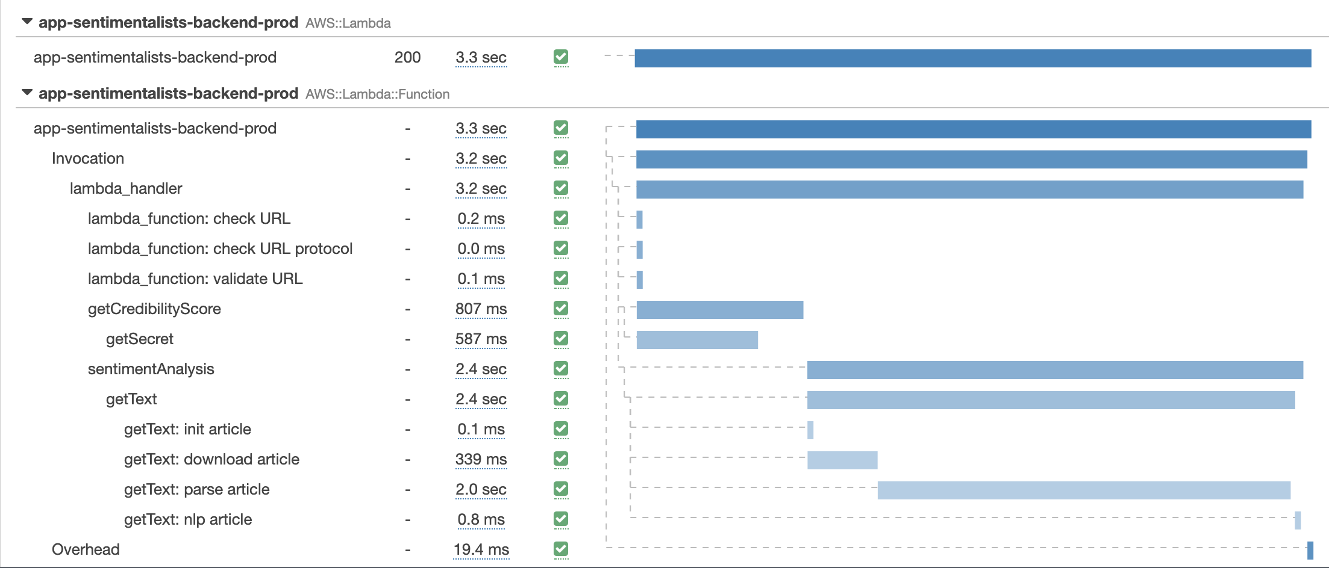
Request Profiling
Using AWS X-Ray to profile requests and identify opportunities for improvement:
Ellie

Slide 12

Final Touches 🏆
Stay tuned for a few fixes and surprises… you’ll see more on Tuesday!

Slide 13
Questions?

